Slide 1
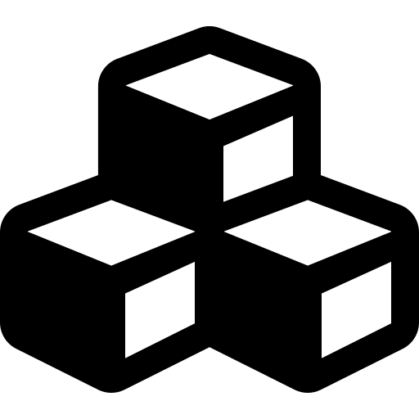
HASHICORP TERRAFORM
Terraform Modules
on AWS
Structure, reusable AWS building blocks, and distributing
modules through GitHub with version references
Module Anatomy
AWS VPC Example
GitHub Source Refs
Versioning
AWS • TERRAFORM • GITHUB

Slide 2
AGENDA
What We'll Cover
01
Module Fundamentals
04
Root Module Usage
What a Terraform module is and why teams standardize on them
Calling the child module from a root configuration
02
Directory Structure
05
GitHub Distribution
The conventional file layout every reusable module follows
Sourcing modules from Git with refs, tags, and subdirectories
03
AWS Module Example
06
Best Practices & References
Building a VPC module: variables, resources, and outputs
Versioning strategy and further reading
TERRAFORM × AWS × GITHUB
02

Slide 3



CONCEPT
What Is a Terraform Module?
A module is simply a folder containing .tf files. Every Terraform configuration has at least one module — the root module — and it can call other, reusable child modules to compose infrastructure.
root module (your .tf files)
module "vpc" { source = ... }
Encapsulation
Groups related resources behind a clean input/output interface
modules/vpc/
main.tf
variables.tf
outputs.tf
Reusability
Write once, call from many environments (dev, stage, prod)
Consistency
Enforces the same tested pattern everywhere it's used
Terraform provisions AWS resources declared inside the child module, using the inputs passed from root.
TERRAFORM × AWS × GITHUB
03

Slide 4



RATIONALE
Why Modularize Your AWS Infrastructure
Don't Repeat Yourself
Guardrails Built In
Team Collaboration
Define a VPC, EKS cluster, or S3 bucket pattern once and reuse it across every project instead of copy-pasting HCL.
Bake security defaults — encryption, tagging, least-privilege IAM — into the module so every consumer inherits them.
Platform teams publish modules; application teams consume them without needing deep AWS provider knowledge.
Composable Design
Environment Parity
Easier Testing & Review
Small, focused modules (network, compute, data) combine into larger environments cleanly.
The same module, called with different variables, produces identical dev/stage/prod topologies.
Changes are reviewed once in the module repo, then rolled out via version bumps.
TERRAFORM × AWS × GITHUB
04

Slide 5
CONVENTION
Standard Module Directory Structure
Terraform's registry convention — every well-formed module follows this shape, regardless of cloud provider.
main.tf
terraform-aws-vpc/
├── main.tf # primary resource definitions
├── variables.tf # input variable declarations
├── outputs.tf # values exposed to callers
├── versions.tf # required_providers / TF version
├── README.md # usage docs, inputs/outputs table
├── LICENSE # open-source license
├── examples/
│ └── basic/ # minimal working example
│ └── main.tf
└── modules/ # optional nested sub-modules
└── subnets/
Declares the AWS resources this module creates (e.g. aws_vpc, aws_subnet).
variables.tf
Defines every input the module accepts, with types, defaults & descriptions.
outputs.tf
Exposes resource attributes (IDs, ARNs) back to the calling configuration.
README.md
Auto-documented by terraform-docs; required for the public registry.
TERRAFORM × AWS × GITHUB
05

Slide 6

AWS EXAMPLE
Example: A Reusable VPC Module
We'll build a small VPC module — one public and one private subnet — then call it from a root configuration.
directory layout
VPC MODULE — WHAT IT CREATES
project-root/
├── main.tf # root module – calls child module
├── variables.tf
├── outputs.tf
├── terraform.tfvars
└── modules/
└── vpc/ # child module
├── main.tf # aws_vpc, aws_subnet...
├── variables.tf
└── outputs.tf
aws_vpc (10.0.0.0/16)
aws_subnet.public
10.0.1.0/24
aws_subnet.private
10.0.2.0/24
TERRAFORM × AWS × GITHUB
06

Slide 7
AWS EXAMPLE
Child Module — variables.tf & main.tf
modules/vpc/variables.tf
modules/vpc/main.tf
variable "vpc_cidr" {
type = string
description = "CIDR block for the VPC"
default = "10.0.0.0/16"
}
variable "environment" {
type = string
}
resource "aws_vpc" "this" {
cidr_block = var.vpc_cidr
enable_dns_hostnames = true
tags = {
Name = "${var.environment}-vpc"
}
}
resource "aws_subnet" "public" {
vpc_id = aws_vpc.this.id
cidr_block = var.public_subnet_cidr
}
Every input a caller can override lives in variables.tf; resources reference those values with var.<name>.
TERRAFORM × AWS × GITHUB
07

Slide 8
AWS EXAMPLE
Outputs & Calling the Module from Root
modules/vpc/outputs.tf
main.tf (root module)
output "vpc_id" {
value = aws_vpc.this.id
}
output "public_subnet_id" {
value = aws_subnet.public.id
}
module "vpc" {
source = "./modules/vpc"
vpc_cidr = "10.0.0.0/16"
public_subnet_cidr = "10.0.1.0/24"
environment = var.environment
}
resource "aws_instance" "app" {
subnet_id = module.vpc.public_subnet_id
...
}
outputs.tf is the module's public interface — the root config reads results via module.<name>.<output>.
TERRAFORM × AWS × GITHUB
08

Slide 9
GITHUB DISTRIBUTION
Sourcing a Module Straight from GitHub
Instead of a local path, point source at a Git repository. Terraform clones it during init.
main.tf — GitHub source variants
module "vpc" {
source = "github.com/myorg/terraform-aws-vpc"
}
# pin to a release tag (recommended)
module "vpc" {
source = "git::https://github.com/myorg/terraform-aws-vpc.git?ref=v1.4.0"
}
# use a module living in a subdirectory of the repo
module "vpc" {
source = "git::https://github.com/myorg/tf-modules.git//vpc?ref=v2.0.0"
}
# SSH form, useful for private repositories
module "vpc" {
source = "git@github.com:myorg/terraform-aws-vpc.git"
}
TERRAFORM × AWS × GITHUB
09

Slide 10

GITHUB DISTRIBUTION
Anatomy of a GitHub Module Reference
git::https://github.com/myorg/tf-modules.git//vpc?ref=v2.0.0
git::
https://github.com/myorg/tf-modules.git
Forces the Git protocol downloader (needed when the host isn't auto-detected).
The repository URL — HTTPS or SSH form both work.
//vpc
?ref=v2.0.0
Double-slash selects a subdirectory inside the repo as the module root.
Pins to a Git tag, branch, or commit SHA — critical for reproducible builds.
TERRAFORM × AWS × GITHUB
10

Slide 11


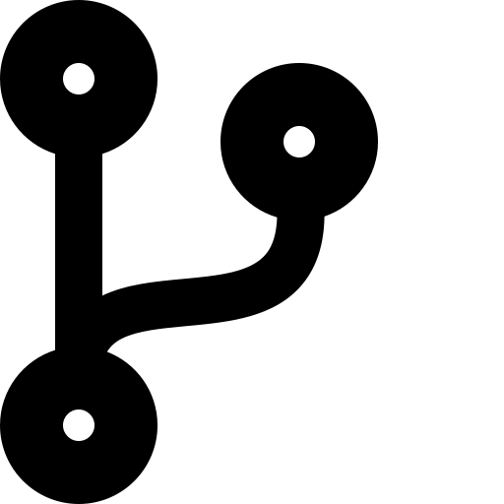
BEST PRACTICES
Publishing & Versioning Modules on GitHub
Name it terraform-<provider>-<name>
Tag every release with SemVer
Ship a README + examples/
Registry convention, e.g. terraform-aws-vpc — enables auto-discovery on the Terraform Registry.
v1.0.0, v1.1.0, v2.0.0 — consumers pin ?ref= to a tag, never to a moving branch.
terraform-docs generates the inputs/outputs table automatically from variables.tf and outputs.tf.
Protect main with CI checks
Avoid provider blocks inside modules
Bump versions deliberately
Run terraform fmt -check, validate, and tflint/checkov on every pull request.
Let the root module configure providers; child modules stay portable across accounts/regions.
Breaking changes → major version; consumers upgrade on their own schedule via ref=.
TERRAFORM × AWS × GITHUB
11

Slide 12




SECURITY
Securing the Module Itself
Bake safe defaults into the module so a consumer has to opt out of security, not opt in.
modules/vpc/variables.tf + main.tf
Mark secrets sensitive
variable "db_password" {
type = string
sensitive = true # redacted from CLI/plan output
}
variable "ingress_cidr" {
type = string
validation {
condition = var.ingress_cidr != "0.0.0.0/0"
error_message = "Open ingress is not allowed."
}
}
resource "aws_s3_bucket_server_side_encryption_configuration" "this" {
rule { apply_server_side_encryption_by_default {
sse_algorithm = "aws:kms"
} }
}
Passwords, tokens, and keys never print in plan/apply output or logs.
Validate risky inputs
validation blocks reject 0.0.0.0/0 ingress or other unsafe values at plan time.
Encrypt by default
Wire KMS/SSE into the resource itself so callers can't silently skip it.
Least-privilege IAM
Scope policies to specific resource ARNs and actions, never Action:"*".
TERRAFORM × AWS × GITHUB
12

Slide 13


SECURITY
Securing Distribution & Supply Chain
Once the module is on GitHub, protect how it's stored, reviewed, and consumed.
Pin to a commit SHA or signed tag
Scan every pull request
Protect the main branch
ref=v2.0.0 or a full commit hash — never a mutable branch like main.
Run tfsec, checkov, or trivy in CI to catch misconfigurations before merge.
Require reviews, signed commits, and CODEOWNERS approval for module changes.
Keep secrets out of Git
Encrypt remote state
Turn on GitHub security features
Pull credentials from AWS Secrets Manager or SSM at apply time, not tfvars.
S3 backend with SSE-KMS, versioning, and a bucket policy that blocks public access.
Secret scanning and Dependabot alerts on the module repository.
TERRAFORM × AWS × GITHUB
13

Slide 14

REFERENCES
Further Reading & Resources
Terraform Module documentation
developer.hashicorp.com/terraform/language/modules
Module Sources — Git / GitHub
developer.hashicorp.com/terraform/language/modules/sources#github
Public Terraform Registry (AWS modules)
registry.terraform.io/browse/modules?provider=aws
terraform-aws-modules (community org)
Questions?
github.com/terraform-aws-modules
Fork a module, pin a ref,
and ship consistent AWS infrastructure.
terraform-docs — README generation
terraform-docs.io
Standard Module Structure guide
developer.hashicorp.com/terraform/language/modules/develop/structure
tfsec — static analysis for Terraform
github.com/aquasecurity/tfsec
Checkov — policy-as-code scanner
checkov.io
14

